Slide 1

Hospitality Project
1
Project Code:P728
Date:14/01/2025

Slide 2

MEET OUR TEAM
2
TEAM MEMBERS :-
Ms. Landge Ruchika Ravindra
Ms. Samikhya Sahoo
Ms. Saloni Sanjay Choudhari
Ms. Sheetal subhash gupta
Ms. Siddhi Dilip Ugale
Mentors:
Mr.Bharat Gunda
Ms.Dipti

Slide 3






3
AGENDA
Project Goal &
Hospitality Introduction
Dataset Description
KPI Analysis
Dashboard Design
Recommendations
Conclusion & Closure

Slide 4
4
INTRODUCTION
Project Overview:
Hospitality Analytics involves the process of collecting, analyzing, and interpreting data specific to the hospitality industry to improve guest experiences, optimize operations, and drive better business decisions. It leverages data to enhance customer satisfaction, manage resources efficiently, increase occupancy rates, and improve revenue management strategies. By analyzing booking trends, customer feedback, and operational metrics, businesses can provide personalized experiences and gain a competitive edge.

Slide 5
5
OBJECTIVES
Analyze Operational Metrics: Review key performance metrics such as occupancy rates, average daily rate (ADR), revenue per available room (RevPAR), and guest satisfaction scores.
Identify Guest Trends and Anomalies: Detect patterns in booking behaviors, seasonal demand shifts, and customer preferences while flagging unusual trends or operational inefficiencies.
Highlight Areas of Excellence and Improvement: Areas needing enhancement to improve guest experience and operational performance.
Develop Analytical Dashboards: Create intuitive dashboards using Excel, Power BI, Tableau, and SQL queries to monitor and visualize critical KPIs for decision-makers.

Slide 6
6
KEY ANALYSIS
The project focuses on analyzing key performance indicators (KPIs) to monitor operations, identify trends, and provide actionable insights. These include:
Provides insights into workload distribution, efficiency, and staff productivity.
Highlights performance gaps or successes in metrics like occupancy rates, revenue per available room (RevPAR), and customer satisfaction.
Evaluates engagement efforts through check-ins, customer feedback responses, and loyalty program touchpoints.

Slide 7
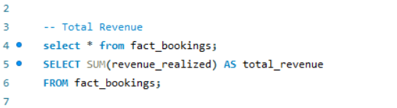

7
Total Revenue
Total Revenue refers to the complete amount of income generated by a hospitality business during a specific time period. It includes revenue from various streams that are critical to the operation and growth of such businesses.

Slide 8
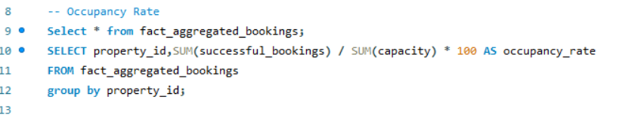

8
Occupancy Rate
The Occupancy Rate measures the percentage of available rooms or units that are occupied during a specific period. It is a key performance indicator (KPI) that reflects how efficiently a property utilizes its capacity to generate revenue. Occupancy rate is crucial for operational planning, marketing strategies, and benchmarking performance against competitors.

Slide 9
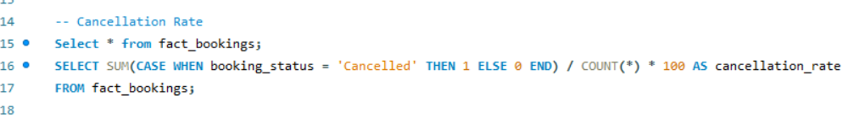

8
Cancellation Rate
Cancellation Rate measures the percentage of bookings that guests cancel compared to the total bookings made over a specific period. A high cancellation rate can indicate inefficiencies or operational challenges, while managing it effectively can help maximize revenue and occupancy.

Slide 10
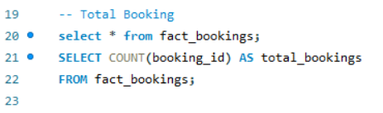

10
Total Booking
Total Booking refers to the total number of reservations or bookings made for accommodations, events, or services within a specific period. It is a fundamental metric for evaluating the performance of a hotel or hospitality business and planning resources effectively.

Slide 11
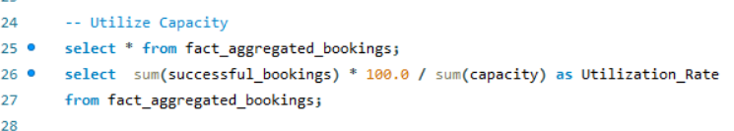

11
Utilized Capacity
Utilized Capacity refers to the percentage of a property’s total available capacity (rooms, event spaces, or other facilities) that is actively in use during a specific period. This metric indicates how efficiently a hospitality business uses its resources to generate revenue and meet guest demands.

Slide 12
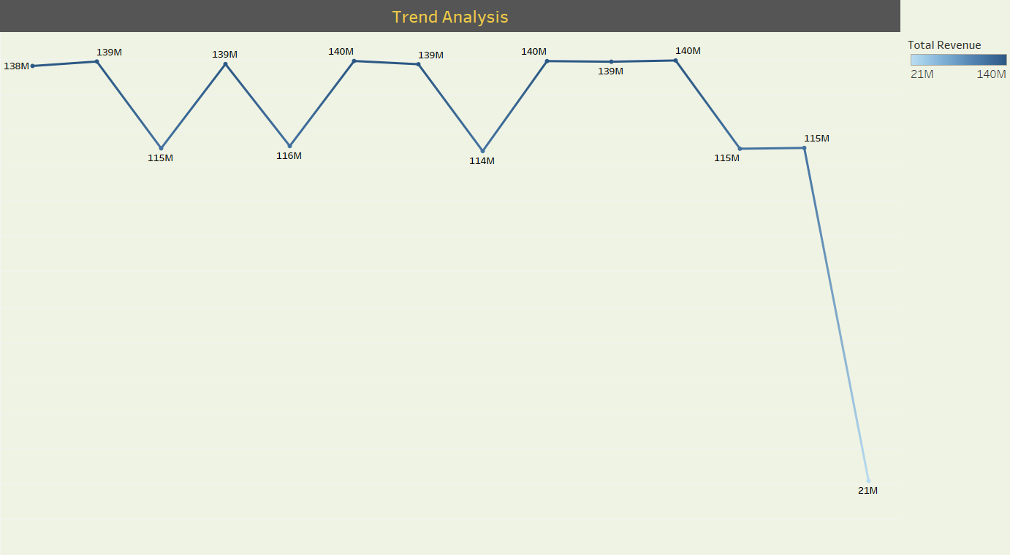
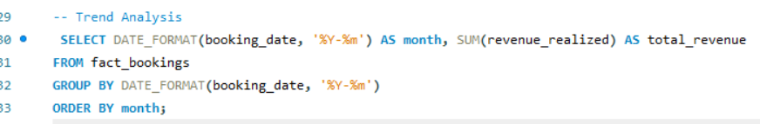
12
Trend Analysis
Trend Analysis is the process of comparing data over a period to observe consistent patterns or irregularities that inform key business decisions. In hospitality, trends can relate to customer behavior, revenue generation, bookings, occupancy, seasonality, and market dynamics.

Slide 13
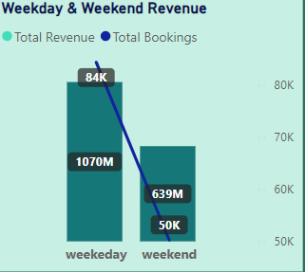
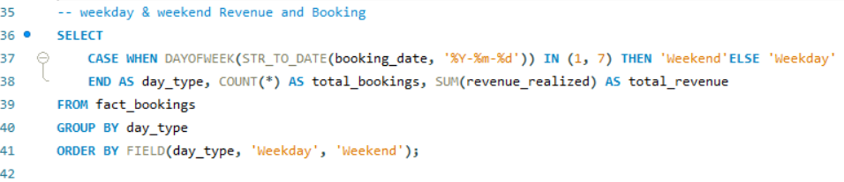
Weekday & Weekend Revenue And Booking
13
In the hospitality industry, analyzing revenue and booking trends for weekdays versus weekends is essential for optimizing strategies, understanding guest behavior, and increasing profitability.

Slide 14
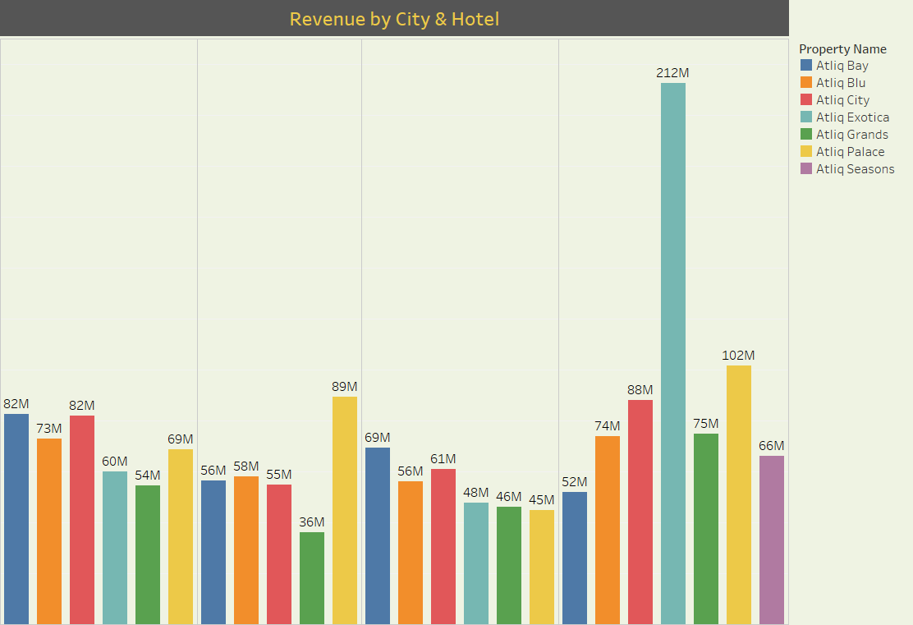
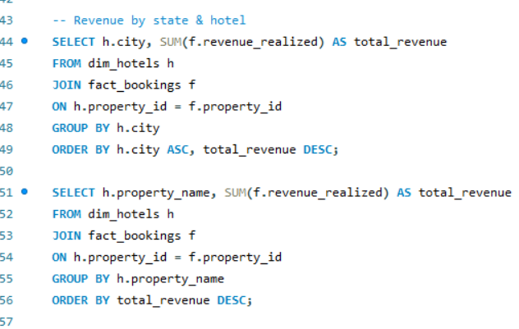
Revenue By City & Hotel
14
Revenue by City & Hotel is a critical performance metric in the hospitality industry, focusing on how revenue varies across locations (cities) and individual hotel properties. This analysis allows hospitality businesses to compare the performance of their hotels in different markets and optimize revenue strategies accordingly.

Slide 15
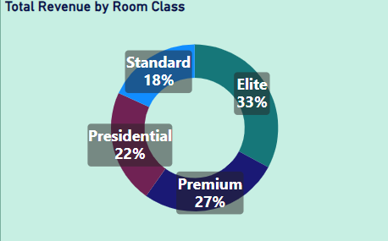
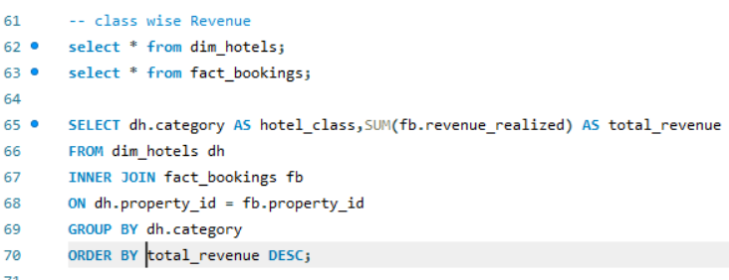
Class Wise Revenue
15
Class-wise revenue analysis involves evaluating the income generated by different types or classifications of rooms, services, or guest segments within a hospitality business. This metric helps understand the revenue contribution from each category, guiding pricing, marketing, and operational strategies.
Class-wise revenue refers to revenue broken down into different segments or categories.

Slide 16
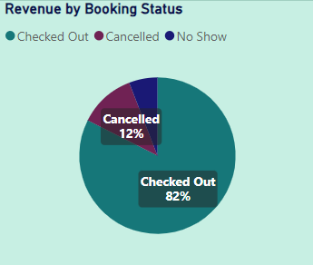
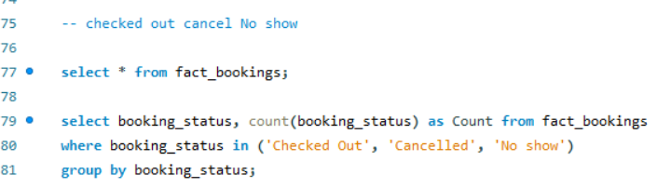
Checked Out Cancel No Show
16
In the hospitality domain, analyzing metrics like checked-out, cancellations, and no-shows is crucial for understanding guest behavior and managing operational efficiency. These metrics help optimize inventory management, revenue forecasting, and customer satisfaction.
CHECKED OUT
CANCELLED
NO SHOW

Slide 17
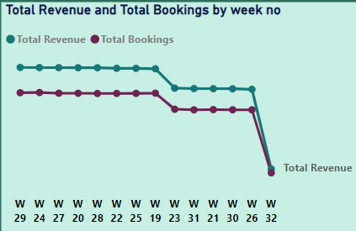
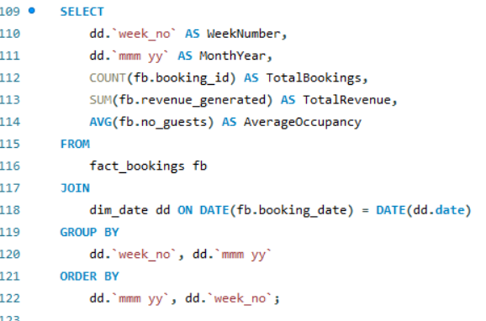
Weekly Trend Key Trend
17
It refers to the analysis and tracking of how different revenue streams fluctuate throughout the week. This analysis helps businesses better understand patterns and make informed decisions about pricing, staffing, marketing, and service offerings.
By identifying peak days and understanding fluctuations across revenue streams, businesses can optimize their marketing efforts, adjust pricing strategies, and plan staffing levels accordingly to meet customer demand and maximize profitability.

Slide 18

18
Dashboard Design
Tools Used:
MS Excel
Power BI
Tableau
MY SQL
Features:
Data Integration and Centralization
Predictive and Prescriptive Analytics
Performance and Productivity Metrics

Slide 19
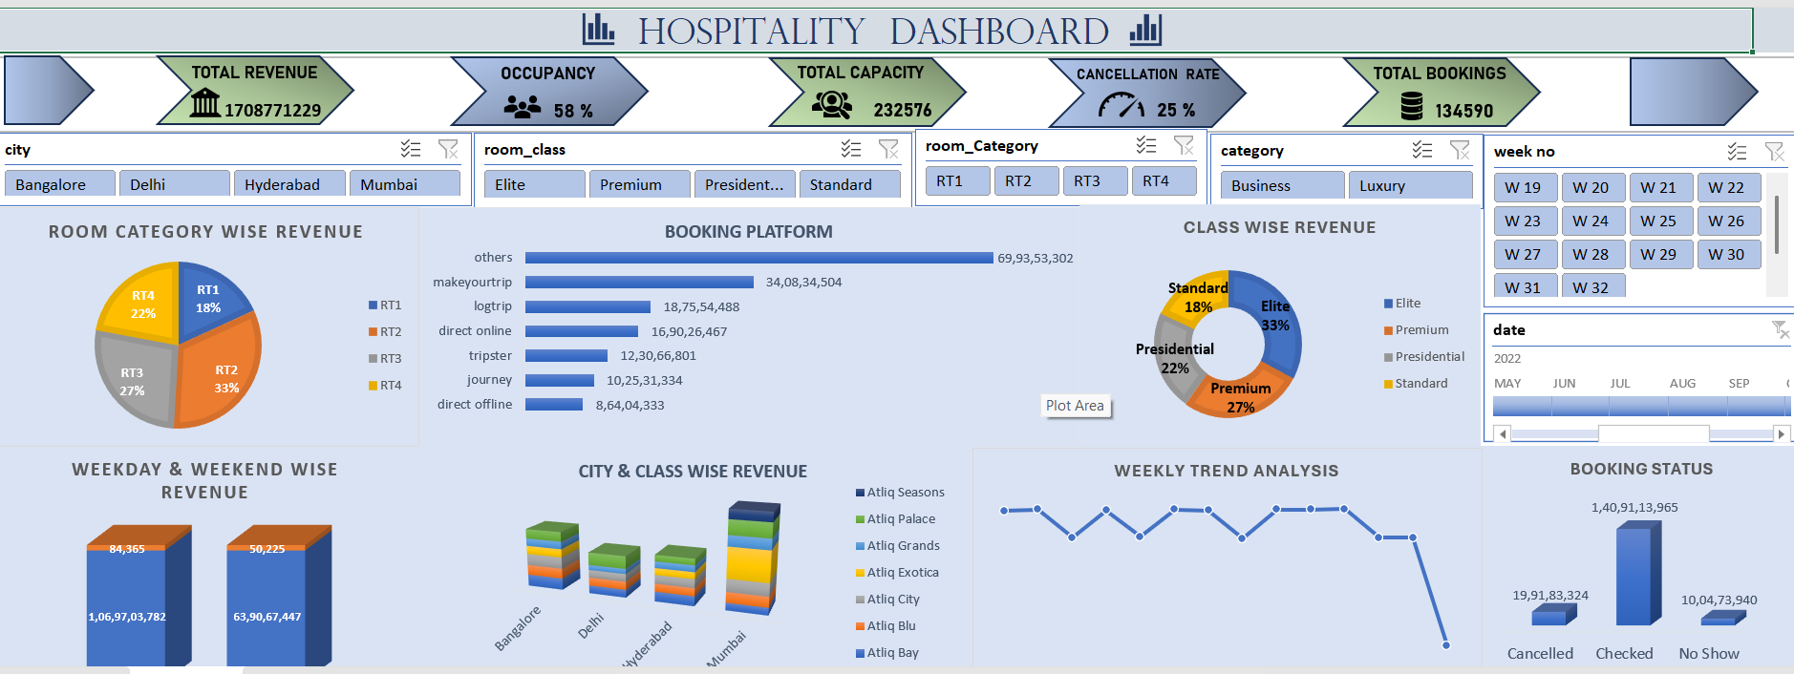
EXCEL DASHBOARD
19

Slide 20
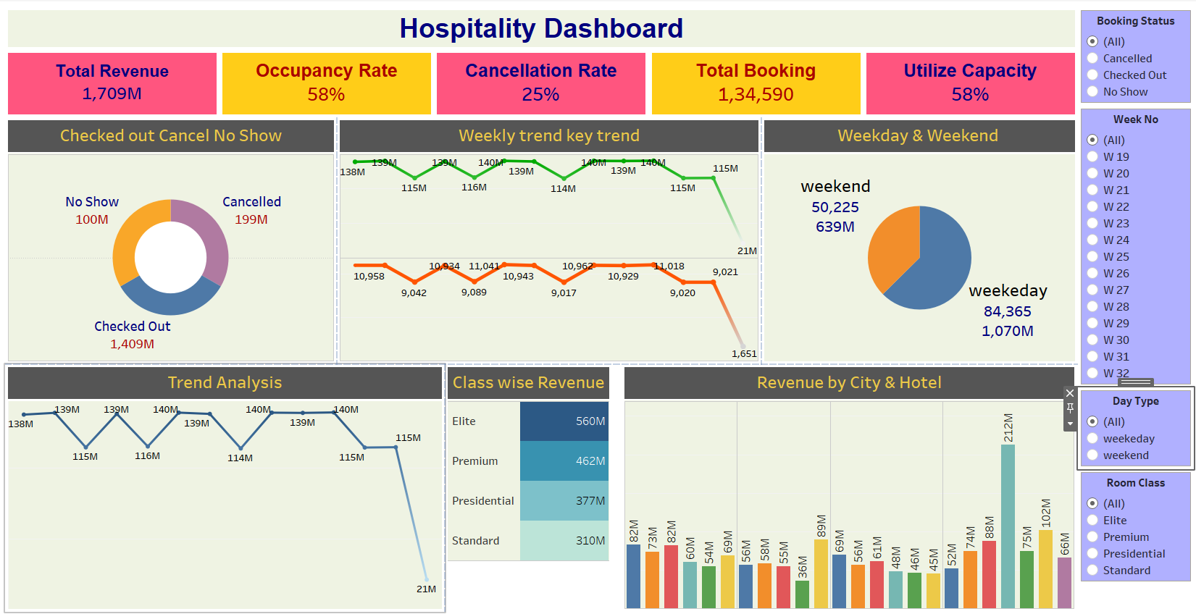
TABLEAU DASHBOARD
20

Slide 21
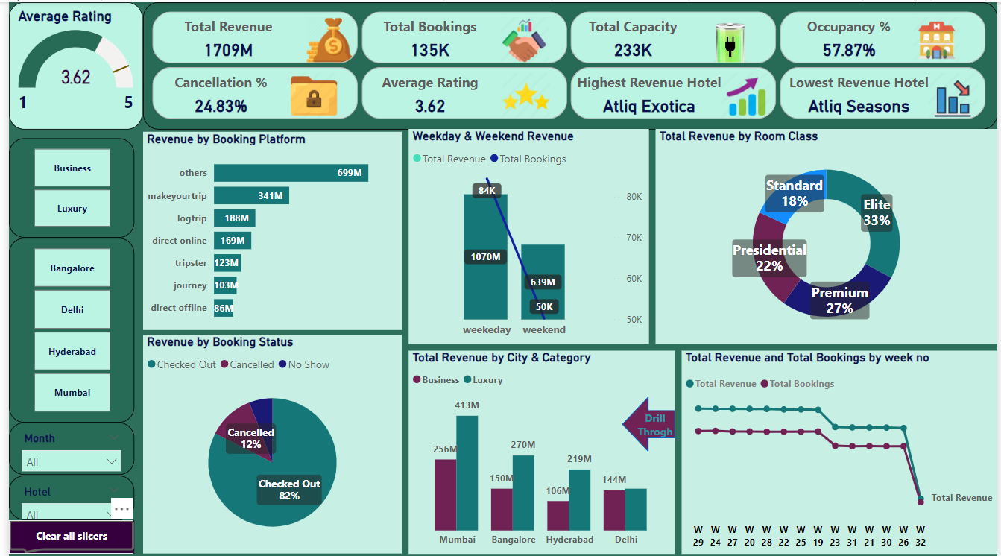
POWER BI DASHBOARD
21

Slide 22
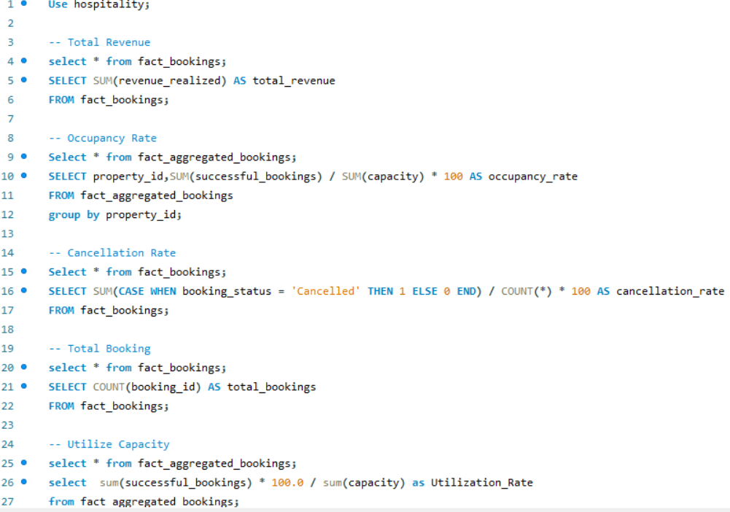
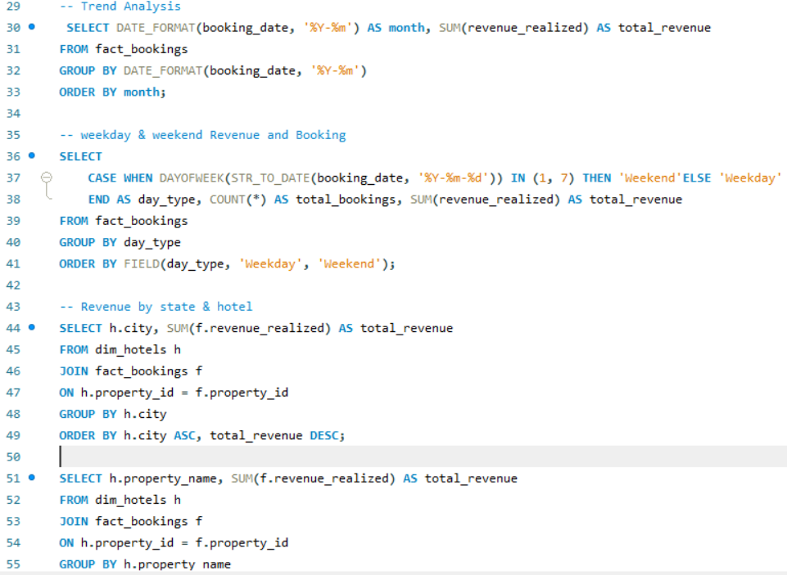
SQL QUERIES
22

Slide 23
Key Insights
23
1.Revenue & Bookings:
Total revenue generated is 1709M with 135K total bookings.
The cancellation rate is 24.83%, indicating a significant loss of potential revenue.
The occupancy rate is 57.87%, suggesting underutilization of capacity (233K total capacity).
2.Performance by Hotels:
The highest revenue-generating hotel is Atliq Exotica, while the lowest performer is Atliq Seasons.
Revenue distribution by room class:
Elite (33%) and Premium (27%) categories dominate revenue.
Standard (18%) and Presidential (22%) rooms contribute less comparatively.

Slide 24
Key Insights
24
3.City-wise Revenue Trends:
Mumbai leads in total revenue (413M), followed by Bangalore (270M), Hyderabad (219M), and Delhi (144M).
Business and luxury segments show variations, with Mumbai excelling in both.
4.Revenue by Booking Platform:
Direct booking platforms contribute the most (699M), followed by other platforms.
OTA platforms are significantly lower, indicating potential for growth.

Slide 25
Key Insights
25
5.Booking Status:
82% of bookings result in checkouts, while 12% are canceled. The no-show rate is low.
6.Weekday vs. Weekend Performance:
Weekdays generate more revenue (1070M) than weekends (639M), with a much higher volume of bookings.
7.Weekly Trends:
A sharp decline in both revenue and bookings is visible after week 27, suggesting possible seasonality or operational issues.

Slide 26
RECOMMENDATIONS
26
1.Reduce Cancellation Rate:
Introduce stricter cancellation policies or incentivize guests to modify dates instead of canceling outright.
Analyze reasons for cancellations and implement targeted solutions, such as offering flexible pricing or promotions.
2.Optimize Occupancy:
Improve marketing for underperforming hotels like Atliq Seasons to boost bookings.
Consider dynamic pricing strategies for low-demand periods to increase occupancy.
3.Focus on High-Performing Categories:
Upsell Elite and Premium room categories through targeted advertising.

Slide 27
RECOMMENDATIONS
27
4.Leverage City Insights:
Focus more resources on cities like Mumbai and Bangalore, which have higher revenue potential.
Explore reasons for lower performance in Delhi and consider localized promotions.
5.Expand OTA Platforms:
Invest in improving visibility and partnerships with online travel agencies to capture more bookings.
Monitor the performance of existing direct booking channels to ensure high ROI.
6.Address Week 27 Decline:
Investigate reasons for the sharp fall after week 27 (seasonality, competition, etc.).
Plan campaigns and promotional events around this period to revive performance.

Slide 28
RECOMMENDATIONS
28
7.Boost Weekend Bookings:
Introduce weekend packages or exclusive offers to attract more bookings.
Partner with local events or tourism boards to enhance demand for leisure travelers.
8.Regular Monitoring:
Use dashboards to track KPIs weekly, such as occupancy, revenue per city, and cancellation trends, for proactive decision-making.

Slide 29
CONCLUSION
29
This project showcases the power of data analytics in transforming the hospitality industry. By analyzing key metrics, guest feedback, and booking patterns, we uncovered actionable insights to enhance efficiency, elevate guest experiences, and boost revenue. These data-driven strategies position the business for sustained success, customer loyalty, and competitiveness in a dynamic market.

Slide 30
Thank You…
30
Group No 6

